Slide 1
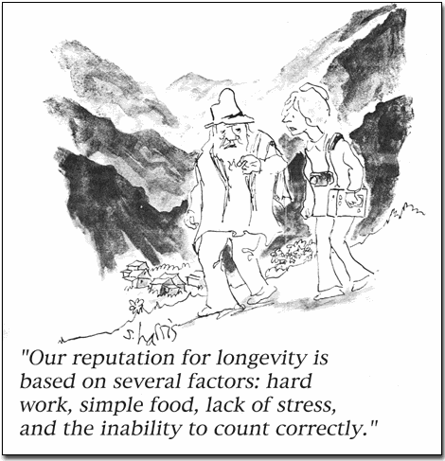

Slide 2

Counting and SOAR
Bill Kennedy
Krasnow Institute, GMU
wkennedy@gmu.edu
June 16, 2005

Slide 3
Counting and SOAR
Biological Basis of a “number module”
Counting Processes
Counting in SOAR
Programming Demos
Notes:
Note: Dummy separator slide. This slide is hidden during presentations.

Slide 4
Number Module
Functions of a Number Module
  Perception of quantities
  Comparisons base on quantity
Evidence for a Number Module
  All societies, all ages, brain localization, fast & automatic, ancestral evidence, relation to mathematics, part of cultural
Notes:
Note: Dummy separator slide. This slide is hidden during presentations.

Slide 5
Counting Processes
Perception of small quantities (~5)
1:1 association procedure
Standards: body parts, tokens, words, symbols
Notes:
Note: Dummy separator slide. This slide is hidden during presentations.

Slide 6
Counting in SOAR
Demos for SOAR FAQ:
  Using elaborations
  Using operators
  Using RHS function
Notes:
Note: Dummy separator slide. This slide is hidden during presentations.

Slide 7
Programming Demos
Programming Soar is difficult
Share the nuggets!
Next:
  Saving transitory sensor inputs?
  Mapping the environment?
  _________________?
Notes:
Note: Dummy separator slide. This slide is hidden during presentations.

